Slide 1
PROJECT DOOR STEP
Sao Paulo
Office Visit- February 14-15, 2000
Report Issued- February ___, 2000
Confidential

Slide 2
Project Doorstep- Sao Paulo
Review Highlights
.
Project Objective:
We performed an on-site review to gain an understanding of the processes, procedures and controls within the Sao Paulo office. Our procedures included interviews with key commercial and accounting personnel. We also performed a test of commodity transactions from deal execution through settlement.
Team Members: Key Office Personnel:
Sally Beck Joe Kishkill - CFO
Ted Murphy Don Black - VP Direct Sales
John Sorrells - AA Kent Castleman - Controller
Mike Jones - AA Brett Wiggs - VP Wholesale
Kate Agnew - AA Plenio Prado - Treasurer
Sue Frusco - Houston
Christine Garcia - Houston

Slide 3
Project Doorstep- Sao Paulo
Current Portfolio
Portfolio Profile:
5 third-party power transactions executed in the last 9 months (3 purchases, 2 sales)
All transactions are physical, fixed price
Term ranges from one month sale to recently signed nine year purchase (Moema)
All transactions were tested from deal execution through settlement.

Slide 4
Project Doorstep -Sao Paulo
Observations
Control Strengths:
Strong ex-patriot presence
  - Jim Bannantine, Joe Kishkill, Kent Castleman, Brett Wiggs, Don Black
Cash disbursements for commodity transactions are reviewed and approved

Slide 5
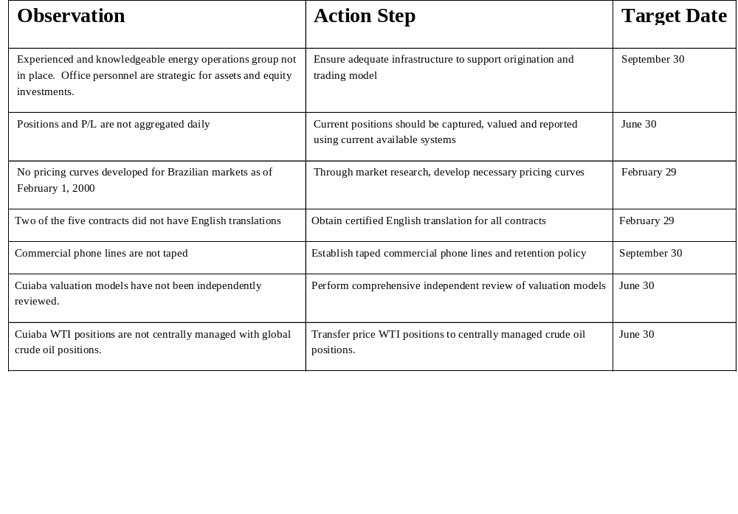
Project Doorstep -Sao Paulo
Observations

Slide 6
Project Doorstep -Sao Paulo
Observations
Areas for Further Review:
Development and integration of Retail products and services
  - Direct sales group formed recently to target retail activity and total energy management
  products
Integration of procurement activities into Enron South America
- Elektro, the recently acquired LDC, is moving operations to ESA
Monitoring of Cuiaba operational risk
  - Operations are directed and records are maintained at the plant site in western Brazil
Supervision and interaction with other Southern Cone offices
  - Offices also exist in Rio de Janeiro, Buenos Aires, Cuiaba, Caracus, Bogota

Slide 7
Project Doorstep- Sao Paulo
Office Analysis Framework
Environment
Market currently does not support “open market” trading and rapid expansion of the trading model. (6 deals to date)
Regulatory authorities require all third-party and self-dealing (Electro) commodity transactions to be approved by Aneel (30 day period to deny)
Currently no significant excess electricity generation, market is supported primarily by hydro.
Stability established and maintained for the local currency.
Contracts are accepted in English or Portuguese, these contracts are required to be denominated in Reais (with few Central bank exclusions).
Industrials capital expenditures directed at maintenance of current asset base, no significant investment in long-term efficiency.
Management
Current management primarily strategic for assets and maintenance of capital investments.
Enron experience and culture present in commercial groups and current supporting operations groups.
Risk management and origination groups currently being developed and responsibilities defined.
Moving support for development of independent back-office function to support trading and origination efforts.
Strategy
Increased focus on development of origination groups:
  Pursuing “shared savings” and energy management programs
  Focus on “creating” electricity and gas marketing.
  Pursuing 20-year long position in gas (27mmbtu/d @ index to swap to fixed at ~$1.00)
  Focus on developing generating / offtake capacity to sell to Elektro
Introduce trading model and pursue organized effort to develop independent back-office function.
Elektro Positioning
  Currently fully contracted
  Initial supply steps down 25% each year beginning 2002
  30% of capacity can be self-dealt
    400-500 mw (2002)
  Anticipate growth potential to manage

Slide 8
Project Doorstep-Sao Paulo
Office Analysis Framework
Systems
No formal trading or risk management system support at this time (will mirror Buenos Aires environment when appropriate).
SAP implemented January 1, 2000
  Accounts Payable
  Financial Reporting
  Project Management
Lotus Notes Databases
ADP outsourced payroll
  To bring in-house during 2000 using SAP Payroll module
Information
Weekly trading position reports (prepared in Houston) for South America prepared for power and natural gas. Crude oil positions monitored daily.
Profit/loss from all trading activities forwarded to management weekly by Houston risk Management.
Primary management reports:
  Deferred cost analysis.
  Weekly net income forecast (by business unit).
  Budget / Actual cost center detail.
Weekly cash position reports.
Counterparties
Focus on equity investments and asset portfolio (TGS, Elektro, Transredes, Cuiaba, BTB, Ceg, Riogas, etc.)
Marketing positions between consolidated and unconsolidated (Electro) affiliates.
Santa Erisa, Moema, Maringa - power counterparties.
Competitors
Electricity - existing LDCs
  Elektro fourth largest in Sao Paulo
  ~25% of customers at risk
Generation - Hydros, furnas coming on-line with 800-1,300 mw nuclear
Business Processes
Legal (Coordinate with Houston on policy exceptions and litigation)
Local HR Admin, currently outsourced payroll to ADP
Local Treasury and Accounts payable
Project operations
Commercial - See attached reporting matrix

